Slide 1
What are YOU doing next year?
Graduate studies in Sociology @ Western
Application for Fall 2024 opens on October 15, 2023

Slide 2
Why Western?
Excellent training in research with internationally recognized faculty
We study population dynamics and social inequality across 5 key dimensions
Competitive funding packages
Research training in 1-year MRP or 2-year thesis stream, or 4-year doctoral program

Slide 3
After the MA degree
Research coordinator, data analyst, project manager, risk strategist, policy analyst, social demographer, non-profit manager, program evaluation, advocate
Ph.D. or other advanced study

Slide 4
After the PhD
Post-doctoral scholar, Assistant Professor, Senior analyst, Centre coordinator, Research associate

Slide 5
Skills learned in graduate school …
Research design and analysis
Critical Thinking
Written & verbal communication
Information management
Time management
Leadership
Flexibility and adaptability
…. a set of experiences that you can draw upon for jobs and interviews

Slide 6
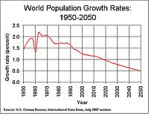
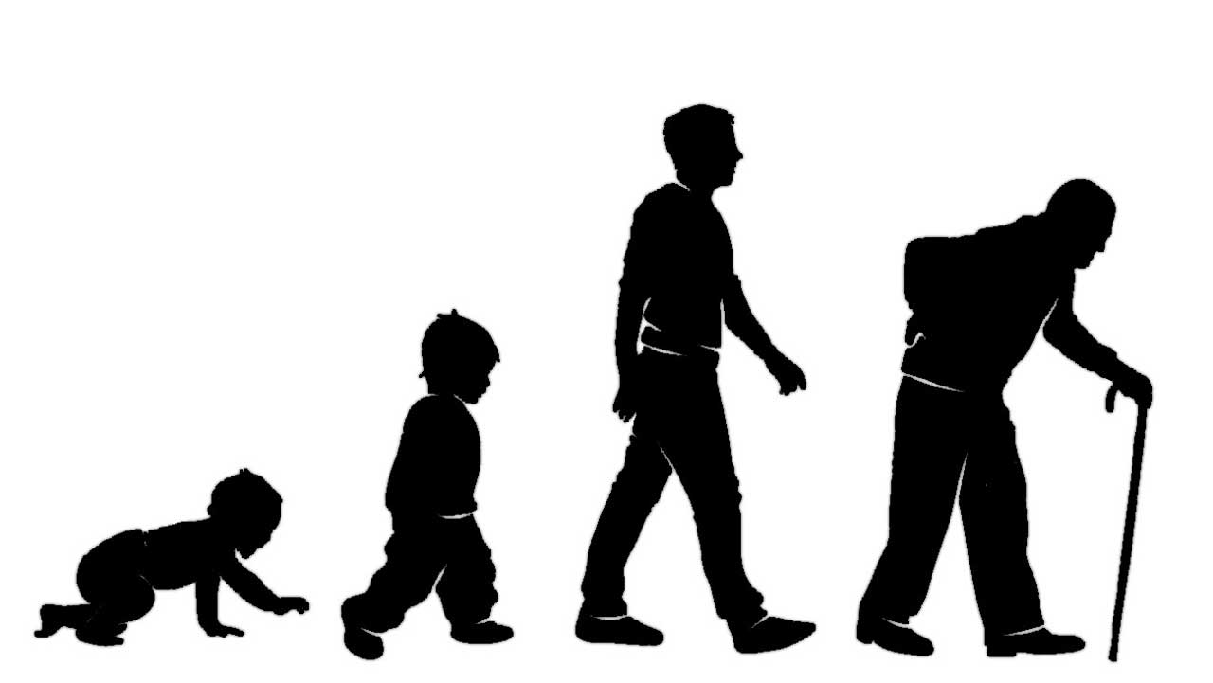

Slide 7
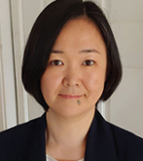
Inequality, power and social regulation
Dr. Waite: gender and sexual orientation and earnings in
Canada
Dr. Yoshida: Race, ethnicity, immigrant integration
Dr. Ramos: Political sociology;
Immigration;
Equity, diversity, inclusion;

Slide 8
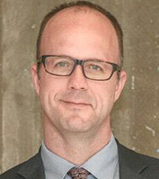
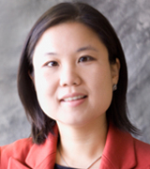
Social demography and migration
Dr. Haan: immigrant settlement, labour market integration
Dr. Abada: Economic and social integration of children of immigrants
Dr. Choi: migration and effects on families and communities

Slide 9
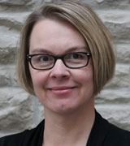
Aging and the Life course
Dr. Zajacova: Education, health across the life course
Dr. Shuey: Health inequality across the life course, work and health

Slide 10
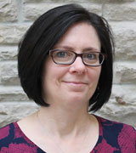
Health and Health inequality
Dr. Margolis: Family, population health
Dr. Willson: Health inequality, effects of early life disadvantage on health

Slide 11
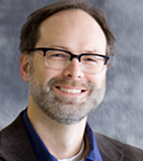
Work, occupations, and professions
Dr. Adams: Gender and feminization in health care professions
Dr. Denice: Race and ethnicity, Education
Dr. Lehmann: Education, work and social class

Slide 12
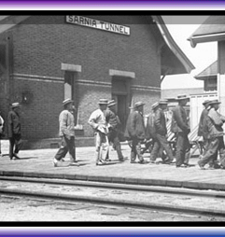
Collaborative graduate specialization in Migration and Ethnic Relations (MER)

Slide 13
Collaborative graduate specialization in Transitional Justice and Post-conflict reconstruction

Slide 14
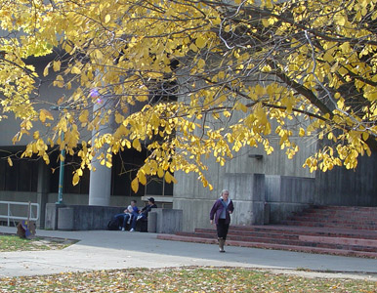
Western’s MA program – 2 streams
Research Paper (MRP) 1 year Stream
6 courses
(3 fall and 3 winter)
Research practicum (winter)
Research Paper
(completed in summer)

Slide 15
Western’s MA program – 2 streams
Thesis Stream
2 year
6 courses (year 1)
Thesis proposal (summer 1)
Complete thesis and defend
(year 2)

Slide 16
Western’s PhD
4 year program
Coursework
Comprehensive exams
Research apprenticeship
Dissertation research

Slide 17
Funding
All Students receive scholarship funding (applied to tuition)
PLUS Teaching Assistantship funding (10 hours/week)

Slide 18
Admission Requirements What do we consider?
Minimum of 78% in last 10 courses
4 year degree in Sociology (or related)
Upper level courses and core sociology courses in methods, statistics, theory
Statement of interest
Letters of reference

Slide 19
MA Admission Requirements What do we consider?
Statement of interest
500 words outlining academic & research interests
How do your interests fit with the department’s 5 areas of expertise?
Do not need a supervisor now, but tell us who you might want to work with

Slide 20
MA Admission Requirements What do we consider?
PLUS
Two letters of reference …
Who should I ask?

Slide 21
Deadline: January 15th, 2024
Questions?
Sandra Vilovski, Graduate Affairs Assistant
svilovsk@uwo.ca

Slide 22
